Slide 1
Software Security Testing
Mahdi shabani

Slide 2
Index
1 Security Testing Definition
2 Security Testing Types
3 Security Test Manifestation
4 Security Test Methodologies
7 RA to Security Testing
5 What we are worry about?!
6 Typical RA taTasks
11 Security Test Execution Environment
13 Security Testing Tools
8 Security Test Plan
9 Security Test Design
10 Security Test Cases
12 Let Start Pentest as a Security Test

Slide 3
Security Testing Definition
A process used to determine that the security features of a system are implemented as designed and that they are adequate for a proposed application environment.
Verify and validate the correctness and effectiveness of security implementation

Slide 4
Security Testing Types
Vulnerability scanning
Various technics & tools
Usually using automated tools
Scan basic known vulnerabilities, known issues using known technics
Security scanning
Assessment manually
Because tools are not 100% perfect
Examining system responses, error messages, system logs
Penetration scanning
Real time simulation environment like mirror or images
Black box, if white then im here, enter to where!!!

Slide 5
Security Testing Types
Security auditing (to supplement security testing)
Specific control for our compliance issues
Usually compliance team are risk evaluating team
procedural level and architectural level
Often investigates areas that are difficult to test in a direct way, such as procedures, policies and controls
Security review (to supplement security testing)
Review standards, architecture diagrams
Performing gap analysis

Slide 6
Security Test Manifestation
Security requirement maturity
Risk Assessment (Thread||Vulnerability||Cost)(output as input of…)
Secure design review(Business Logic Testing)
Application security test (SAST+DAST=IAST)

Slide 7
Security Test Methodologies
Model-based security testing,(design model)
Code-based testing and static analysis,(implementation)
Penetration testing and dynamic analysis,(on running)
Security regression testing (during maintenance)

Slide 8
What we are worry about?!
We need output of RA as input of Security test design
We need output of asset assessment as input of RA through detect:
Assets
Value of assets
Location of assets
Access channel of assets
Assets protection controls (security establishment)
We need security policy
So we are worry about assets protection controls existence and efficiency and adequacy

Slide 9
Typical RA taTasks [NIST 88-30]
Identify relevant threat sources
Identify threat events from those sources
Identify vulnerabilities could be exploited by those threat events
Determine the likelihood successful threat events
Determine the impacts and ranking process

Slide 10
RA to Security Testing
Security policy
Security testing policy
Security testing goals & objectives
Security testing Strategy & approaches
Security testing plan & design test cases
Security test evaluation & report & maintenance

Slide 11
Security Test Plan
Scope of the project
Objectives
Target market
Assumptions
Testing cycle start/end dates
Major roles and responsibilities/overall resources
Testing environment
Deliverables
Major risks and how to handle these risks
Defect reporting and mitigation
Testing end date
To testing teams and other teams or stakeholders

Slide 12
Security Test Design
Security test attributes would be considered:
Prioritized by identified security risks and threat models
Traced to defined security requirements
Defined based on the intended audience (developers, functional testers, security testers)
Defined based on security defect profiles
Designed to be automated, if applicable

Slide 13
Security Test Design
Rings of security test design :
The security test approach (project level)
Security test risks, threat models and requirements (project level)
Security test design techniques (based on risks, requirements and application)
Security test cases and scenarios

Slide 14
Security Test Design
Common security risks and vulnerabilities:
Functional Security Controls
Functional Access Controls
Structural Access Controls
Secure Coding Practices
Operating System Access
Language Vulnerabilities
Platform Vulnerabilities (OS)
External Threats
Internal Threats

Slide 15
Security Test Cases
Test data
Procedures/inputs
Scenarios
Descriptions
Testing environment
Expected results
Actual results

Slide 16
Security Test Execution Environment
Isolated
Complete
Operating system (exact version and configuration)
Networking
Middleware
Desktop (hardware brand, processor, memory)
Mobile device (manufacturer, processor, memory, power management)
Database
Access rights
Browsers and plug-ins
Co-existing applications
Data (engineered test data or production data that has been obfuscated)
Restorable

Slide 17
Let Start Pentest as a Security Test Our sample process
Start sec test project and review meeting and taking brief
Getting objective and goals and strategic view points
Making security test plan
Making security test design or choosing it from choices
Pre-engagement Interactions
Intelligence Gathering
Threat Modeling based on agile RA
Vulnerability Scanning & Analysis
Exploitation & Post Exploitation
Reporting
Fire (Doing it in an isolated environment)

Slide 18
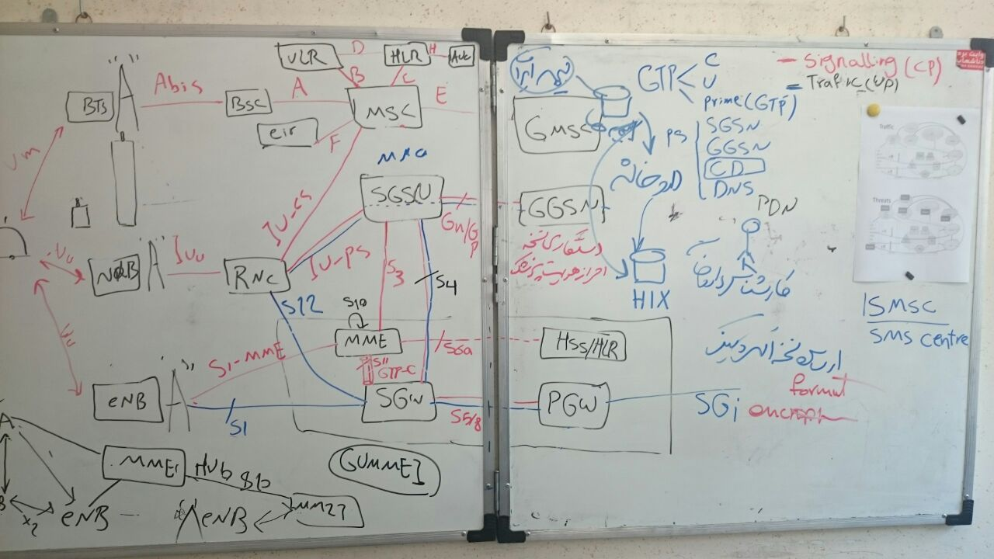
Security Test Design and Execution
Pre-engagement Interactions
Scope?
Schedule?
Blackbox or Whitebox?
Contacts?

Slide 19
Security Test Design and Execution
Intelligence Gathering
Threat Modeling

Slide 20
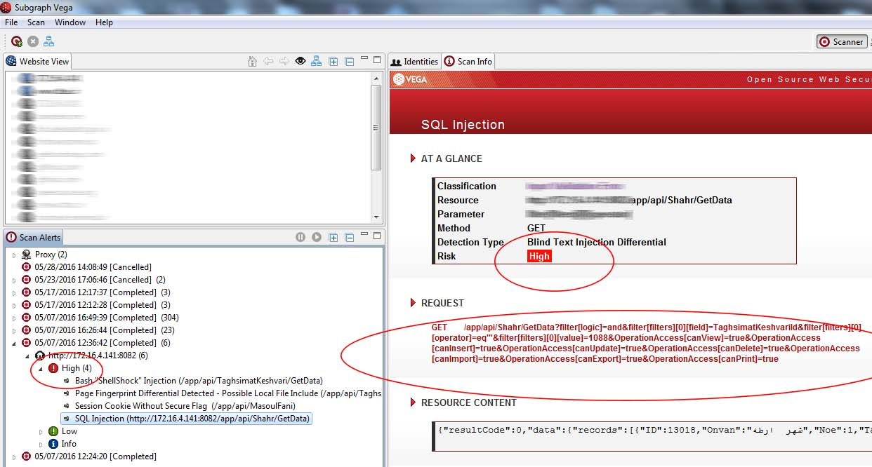
Security Test Design and Execution
Vulnerability Scanning & Analysis (Automated)

Slide 21
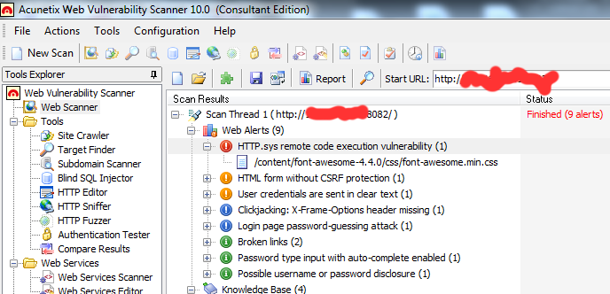
Security Test Design and Execution
Vulnerability Scanning & Analysis (Automated)

Slide 22
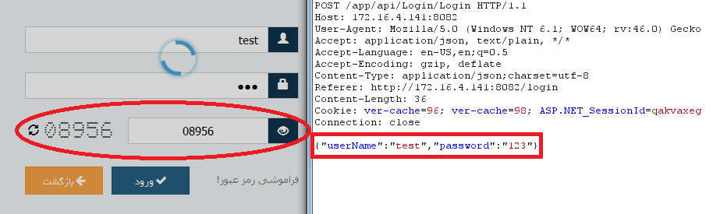
Security Test Design and Execution
Vulnerability Scanning & Analysis (Manualy)

Slide 23
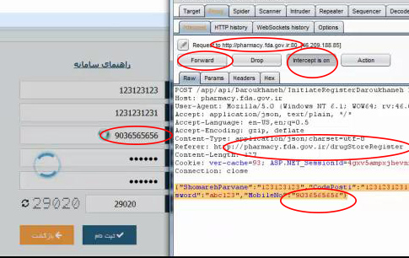
Security Test Design and Execution
Exploitation

Slide 24
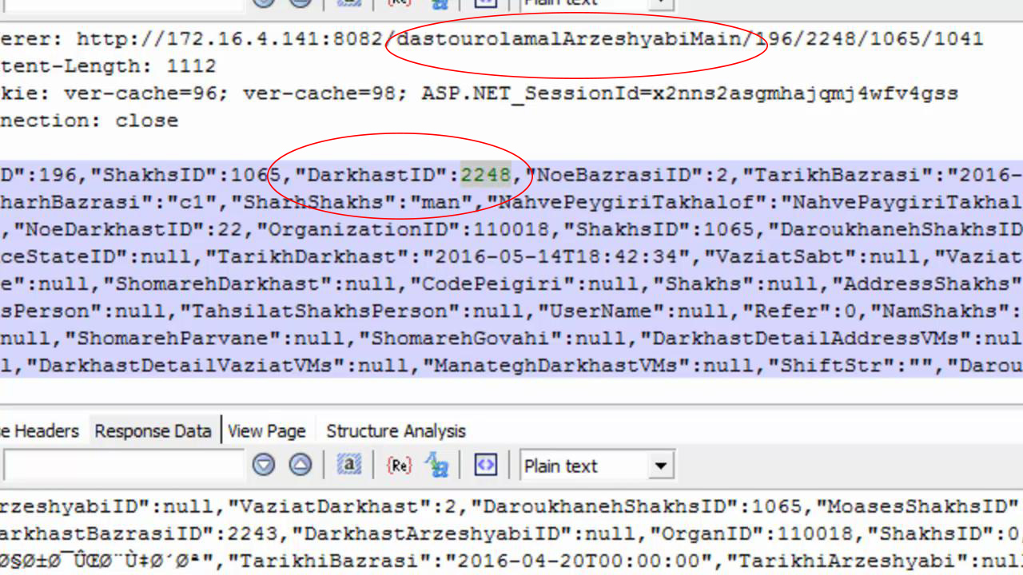
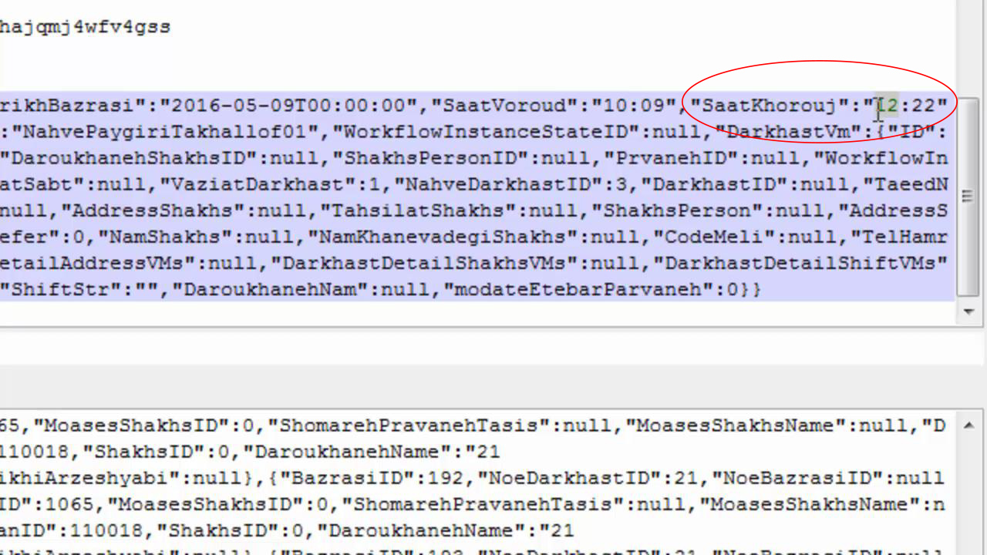
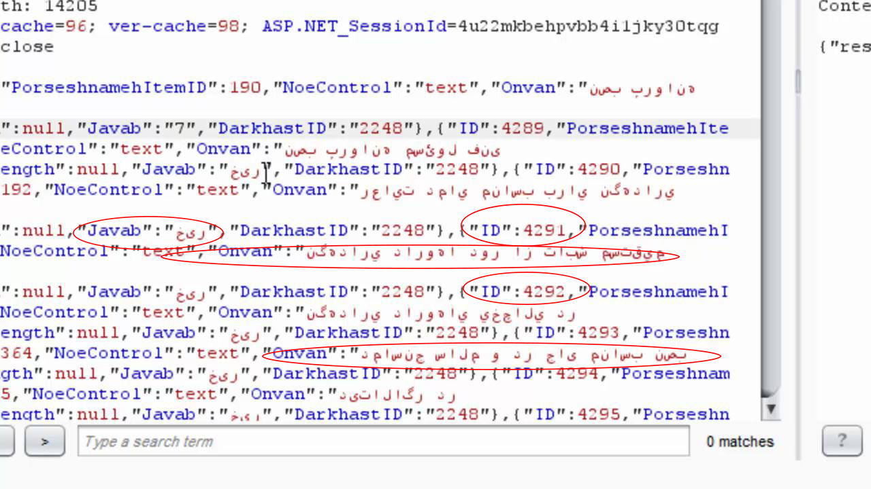
Security Test Design and Execution
Post Exploitation

Slide 25
Security Test Design and Execution
Reporting

Slide 26
Security Testing Tools
Vulnerability Scanning
ISS, Foundscan, Nessus, Nikto
Penetration Testing (Black Box Testing)
Webinspect, Appscan, Hailstorm, Paros, Peach
Binary Analysis/Reverse Engineering
IDA Pro, @stake SmartRisk
Source Code Analysis
Fortify, Klockworks, Parasoft, Free Tools (e.g. FindBugs)
Threat Modeling
MS TAM, TRIKE, PTA Technologies
Rootkit BackDoor Analysis
rootkits.org and rootkit.nl

Slide 27
Q & A
Mh.shaabani@gmail.com

